Slide 1
4750 N. Sheridan Road
Chicago, IL 60640
Terry Bergdall
Part 2

Slide 2
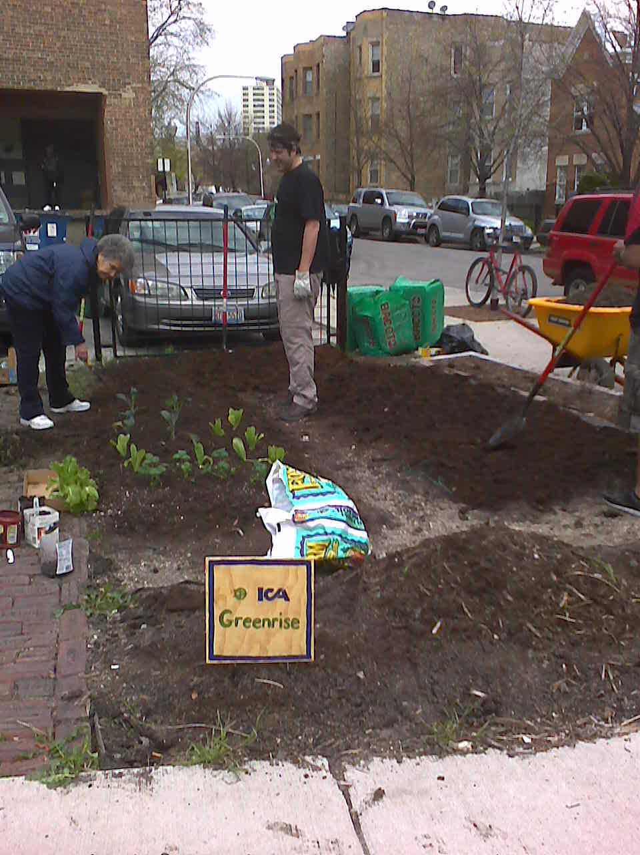
Uptown
Community
Engagement

Slide 3

Identify - Connect - Accelerate

Slide 4
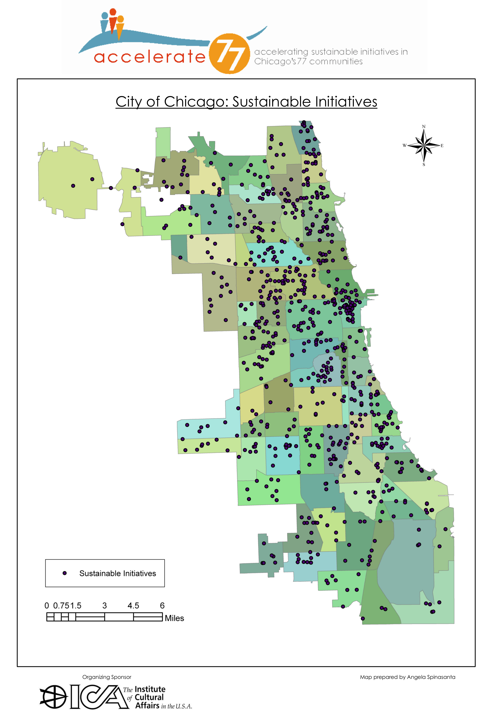

Slide 5
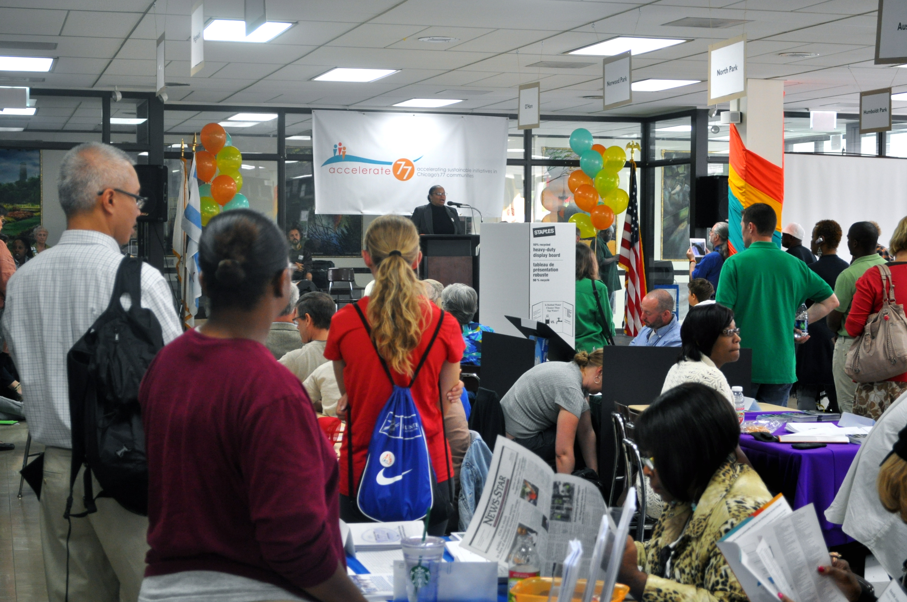

Slide 6
Chicago Sustainability
Leaders Network
In-between space of top-down and bottom-up
        Collaborative government
Continue the creation of lateral connections
Expanding the table
Empower vertical relationships
        Strengthening the voice from below
Develop “soft skills” of community work
        Sustainability U

Slide 7

4750 N. Sheridan Road

